Slide 1
Double Peaks
Week 2

Slide 2
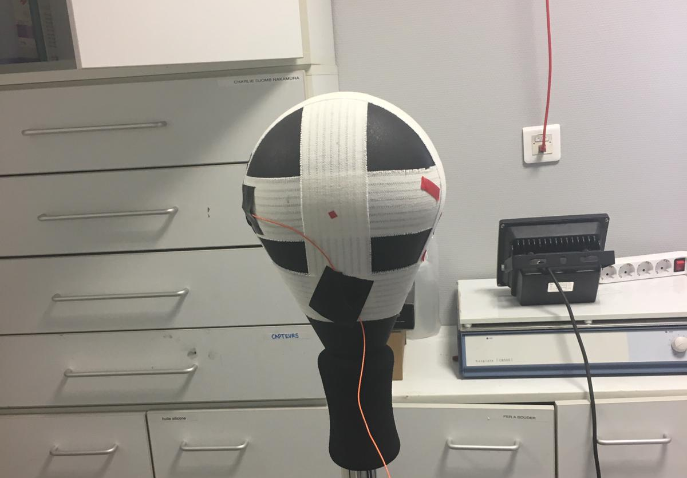
Impacts on a punching ball
Impact
Sensor

Slide 3
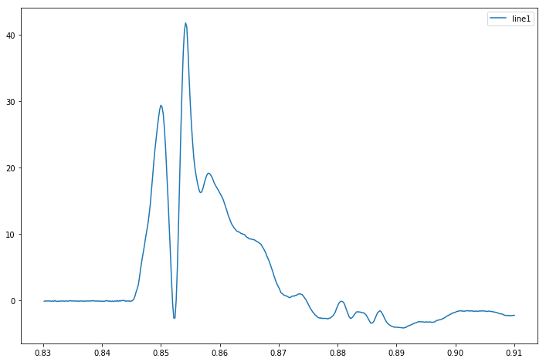
Summary of idea
We propose that the two peaks correspond to rigid and elastic reponses
Corresponds to elastic reaction at point of measure
Corresponds to rigid reaction of center of mass
Time taken for shockwave to propagate to point of measure

Slide 4
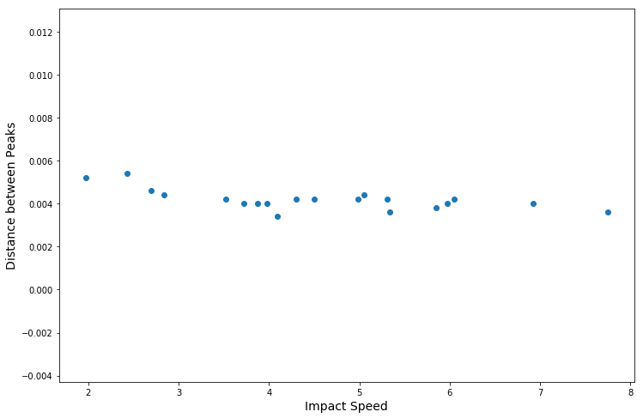
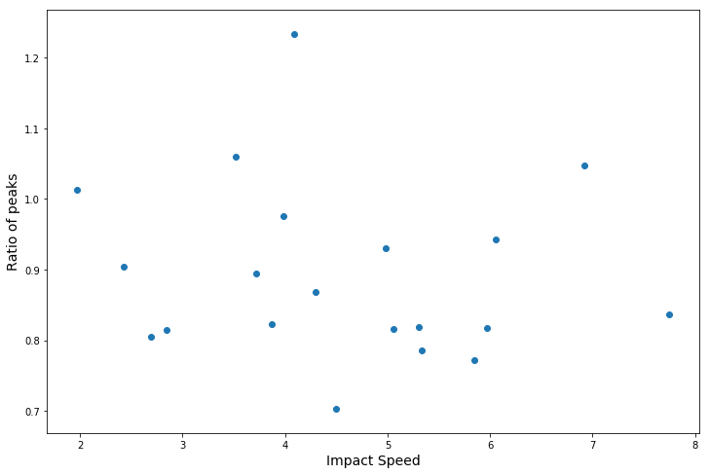
Effect of varying Impact speed

Slide 5
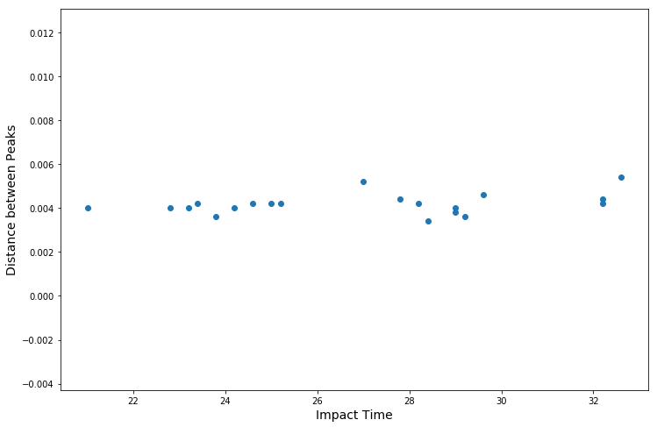
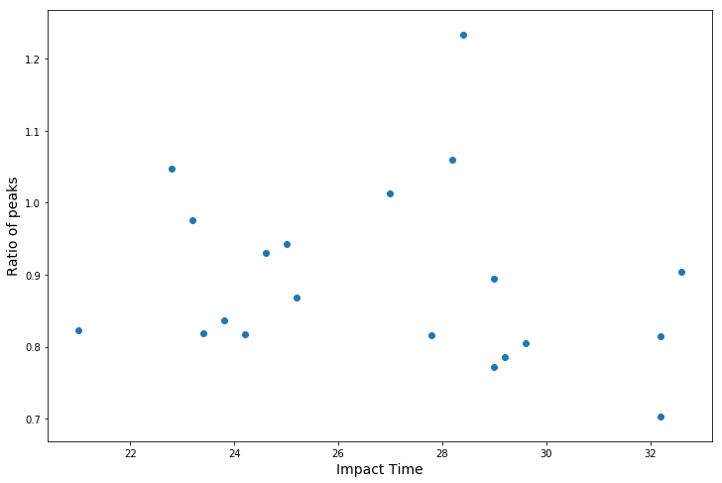
Effect of varying Impact Time

Slide 6
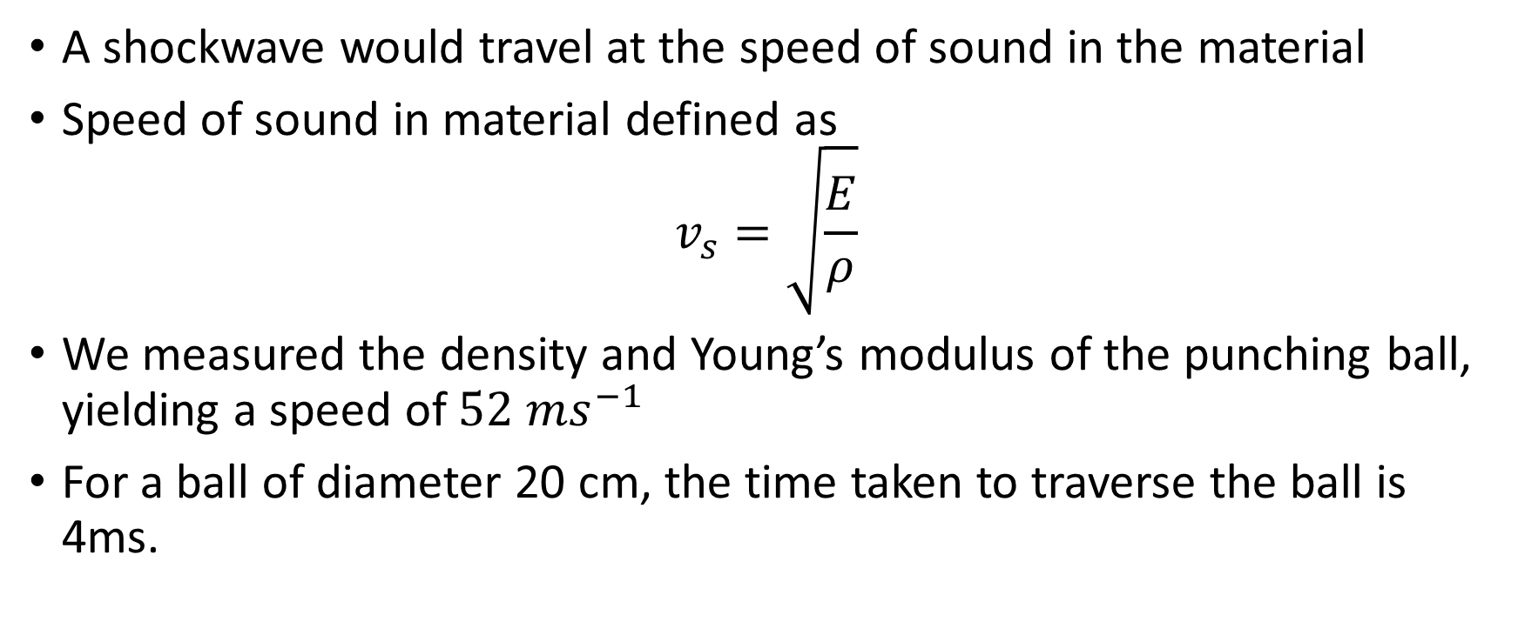
Investigating a potential shockwave
A shockwave would travel at the speed of sound in the material
Speed of sound in material defined as $v_{s}=\sqrt{\frac{E}{ρ}}$
We measured the density and Young’s modulus of the punching ball, yielding a speed of $52 ms^{−1}$
For a ball of diameter 20 cm, the time taken to traverse the ball is 4ms.

